Slide 1
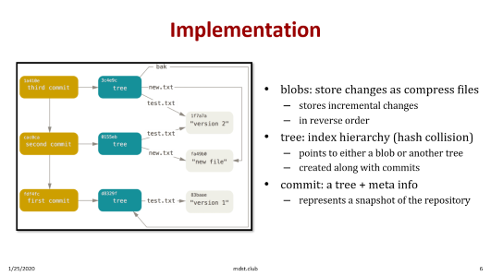
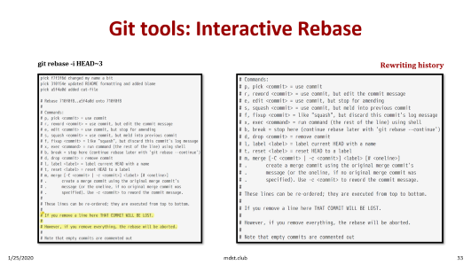
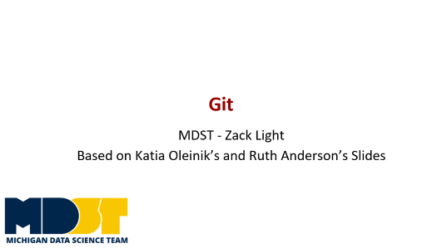
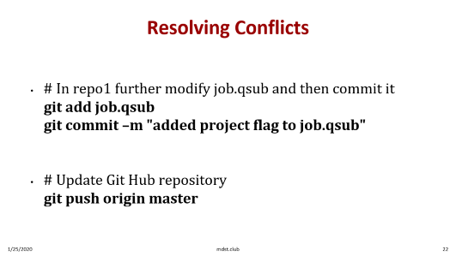
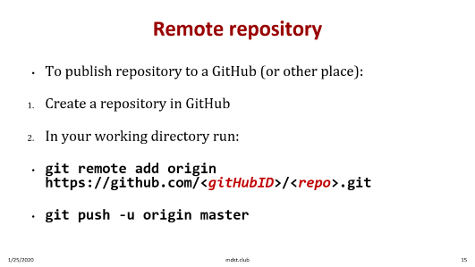
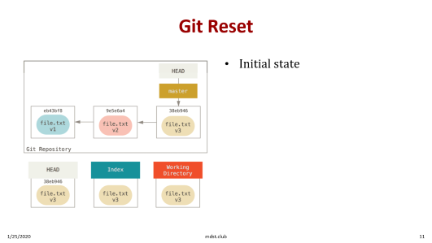
Outline

Slide 2

Git
MDST - Zack Light
Based on Katia Oleinik’s and Ruth Anderson’s Slides

Slide 3
Zack
Read ProGit, the “Bible” for Git
Trained to use Git and GitHub from Internships
Managed open source project with over 800 GitHub stars

Slide 4
Installation
Follow the Command Line Tools Section:
https://eecs280staff.github.io/p1-stats/setup.html#command-line-tools

Slide 5
History
Created by Linus Torvalds, creator of Linux, in 2005
Designed to do version control on Linux kernel
Now used to version control virtually everything

Slide 6
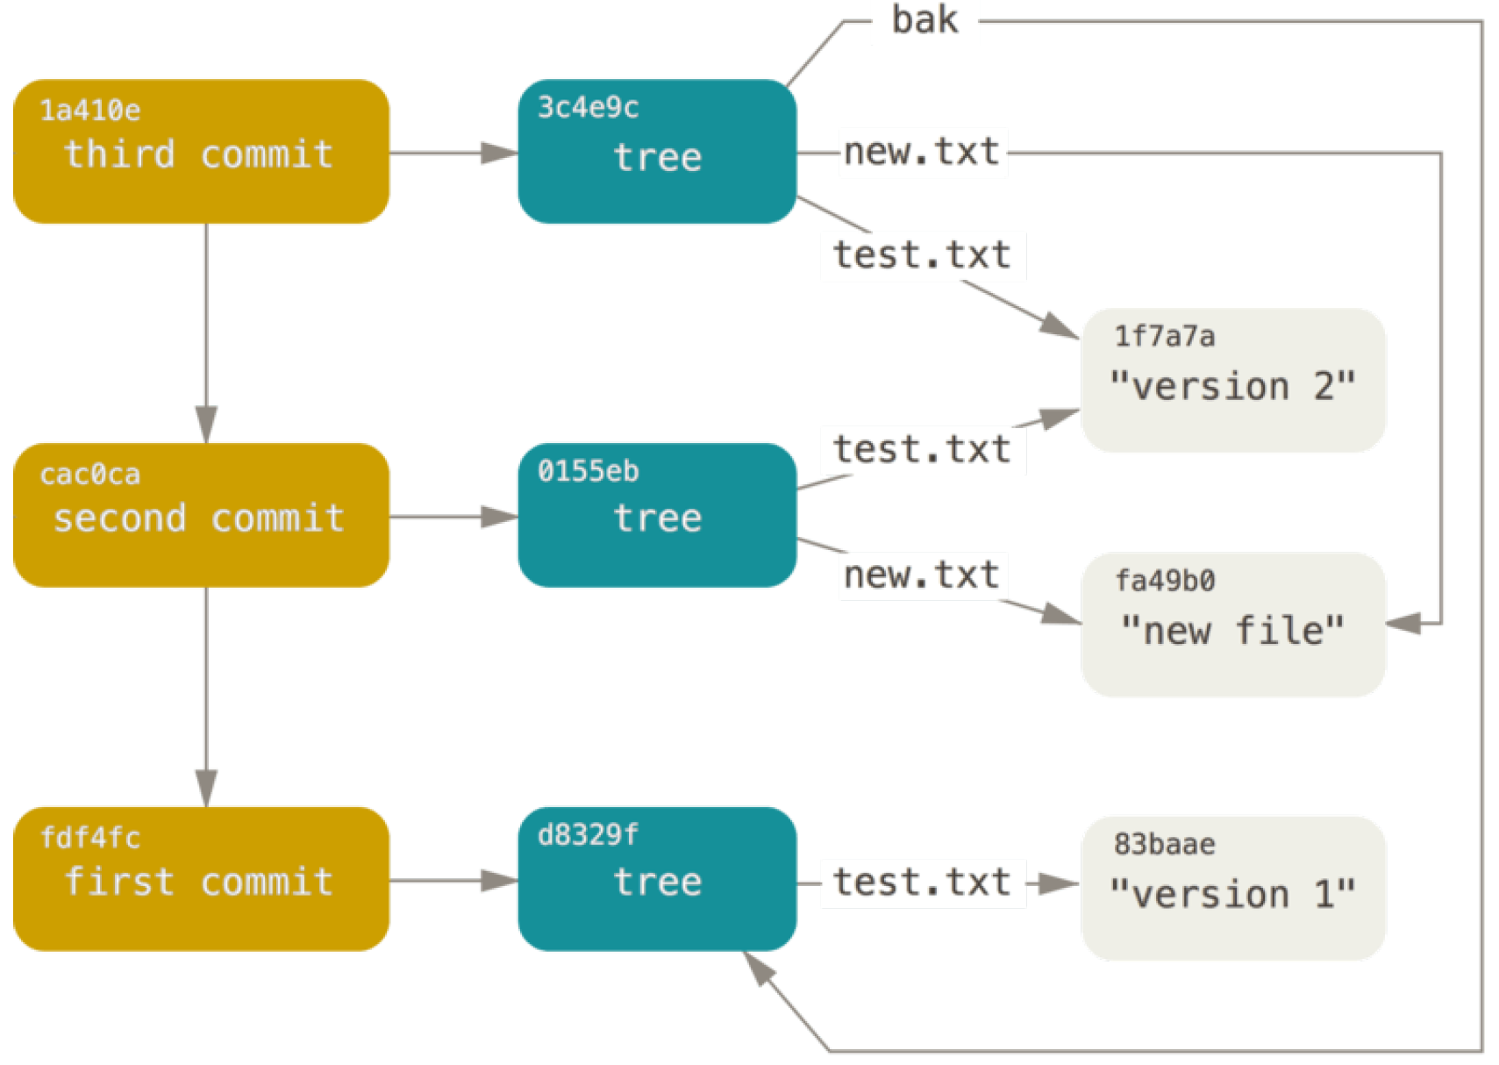
Implementation
blobs: store changes as compress files
stores incremental changes
in reverse order
tree: index hierarchy (hash collision)
points to either a blob or another tree
created along with commits
commit: a tree + meta info
represents a snapshot of the repository
Notes:
Every arrow is a pointer

Slide 7
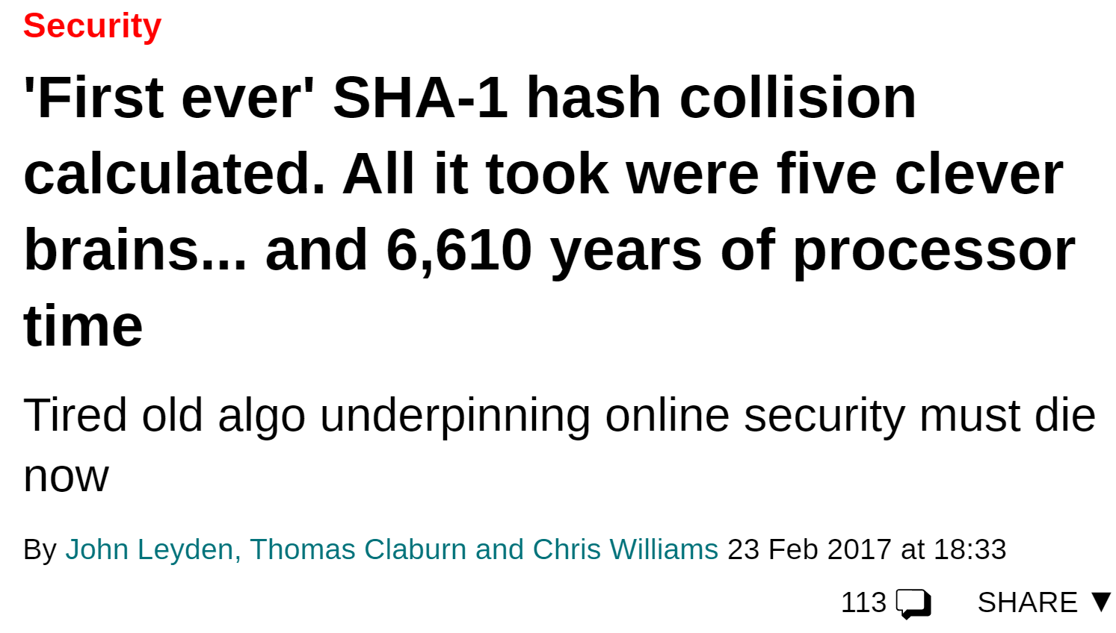
Hash Collision
“a SHA-1 collision is less
likely than every member of your programming team being attacked and killed by
wolves in unrelated incidents on the same night.”
-- The Git Bible

Slide 8
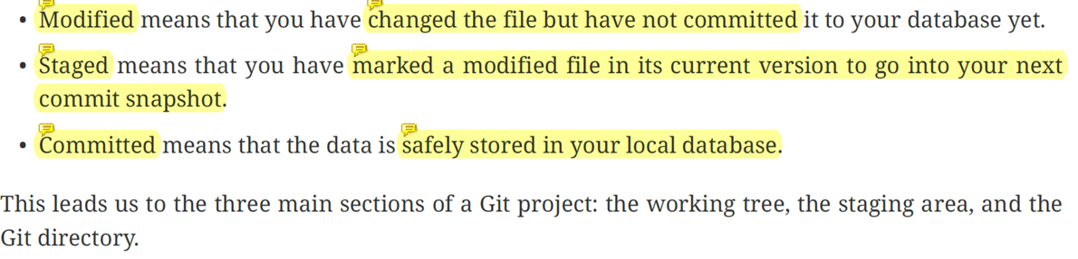
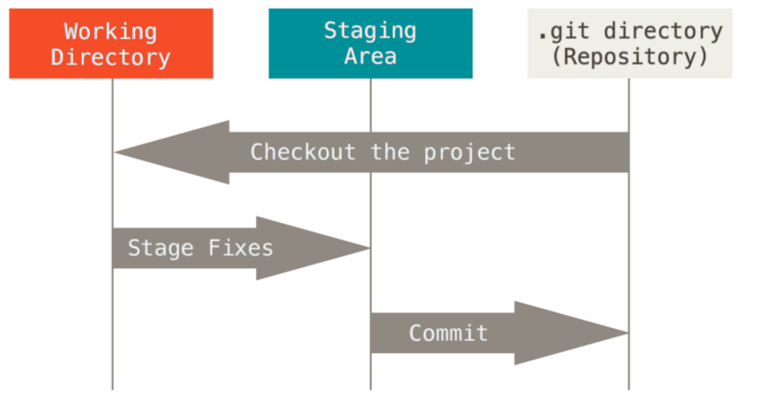
3 Stages of Changes
Notes:
an example for why we have staged

Slide 9
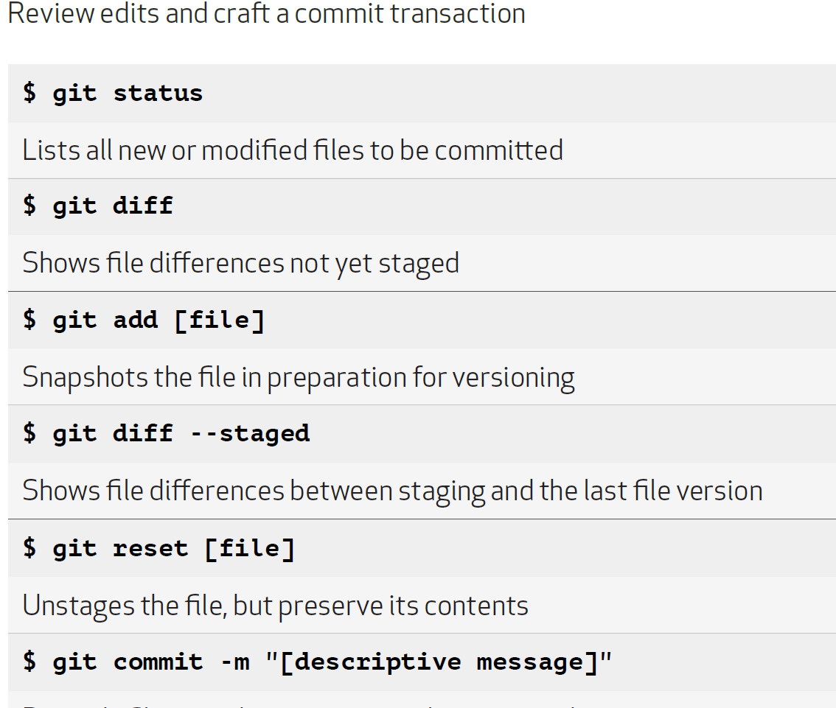
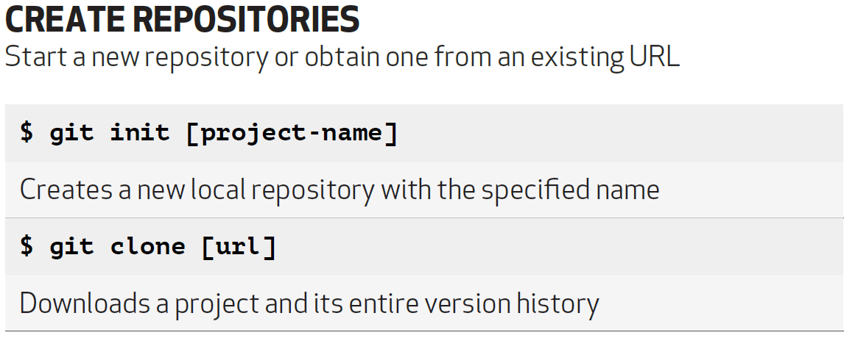
Basic Commands
Notes:
clone: usefulness
git add *
git add .

Slide 10
An example workflow
# New project
git init
emacs rea.txt #Make some changes
git status -s
M rea.txt
git add .
git commit –m “Add rea.txt”
# Make new changes…
git status
# modified: rea.txt
git diff
diff --git a/rea.txt b/rea.txt
git add rea.txt
git commit -m "Created new text file“
# Oops forgot some changes/a bug
emacs rea.txt #make some changes
git commit --amend
#Everything is good
git push
Notes:
git add .
git commit –m “Add rea.txt”
vs
git commit –am “msg”

Slide 11
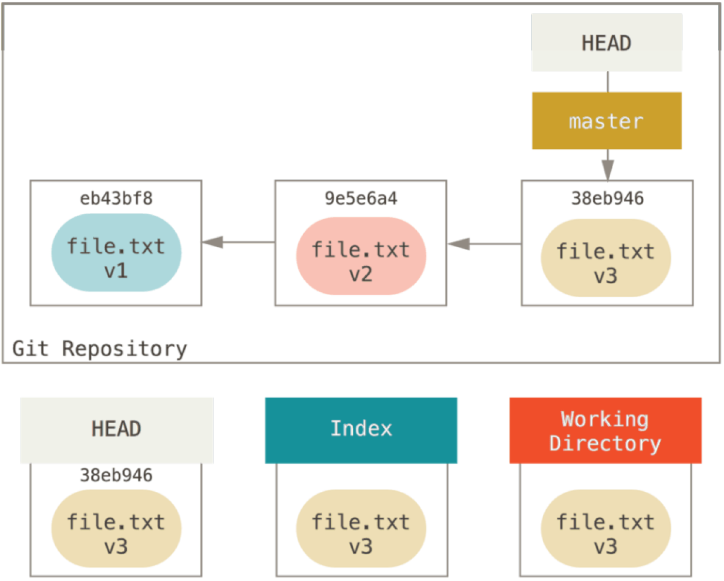
Git Reset
Initial state

Slide 12
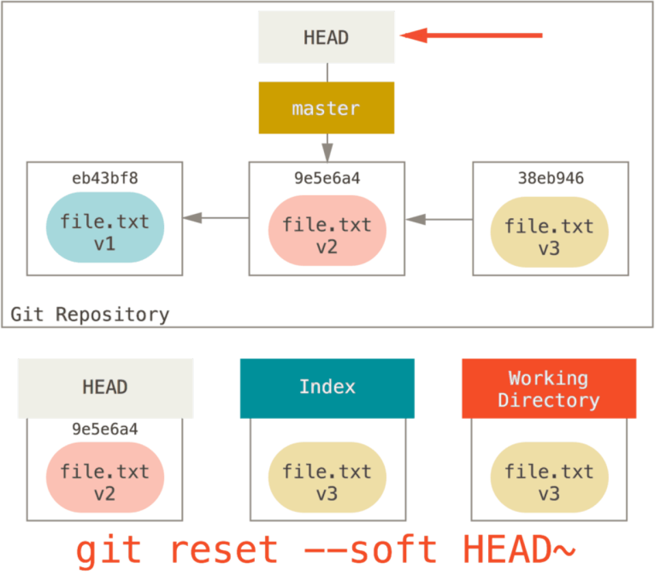
Git Reset
undo your commit
+
keep working directory changes
+
keep staged changes

Slide 13
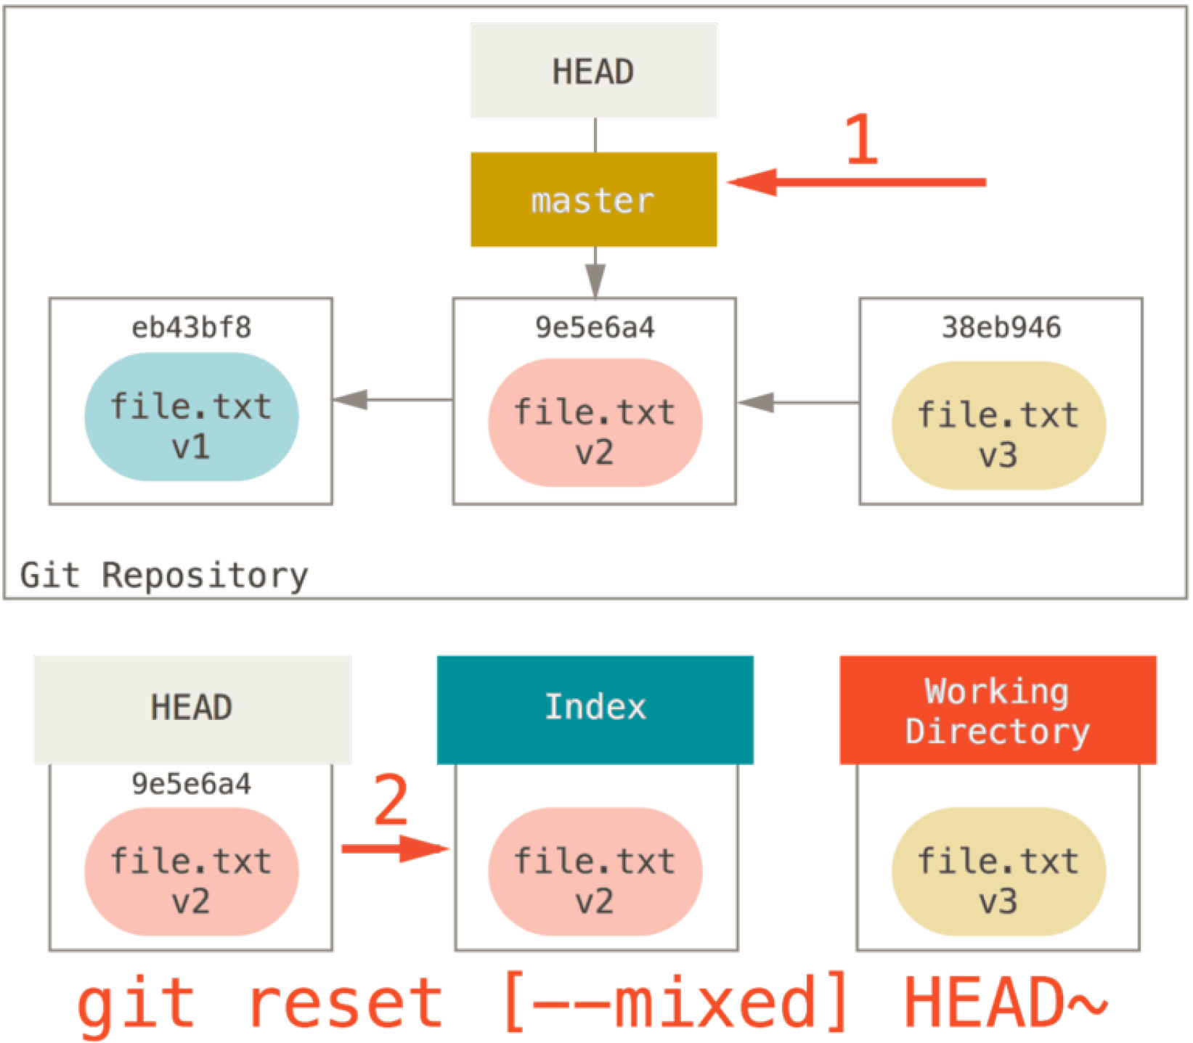
Git Reset
undo the commit
+
undo the staging

Slide 14
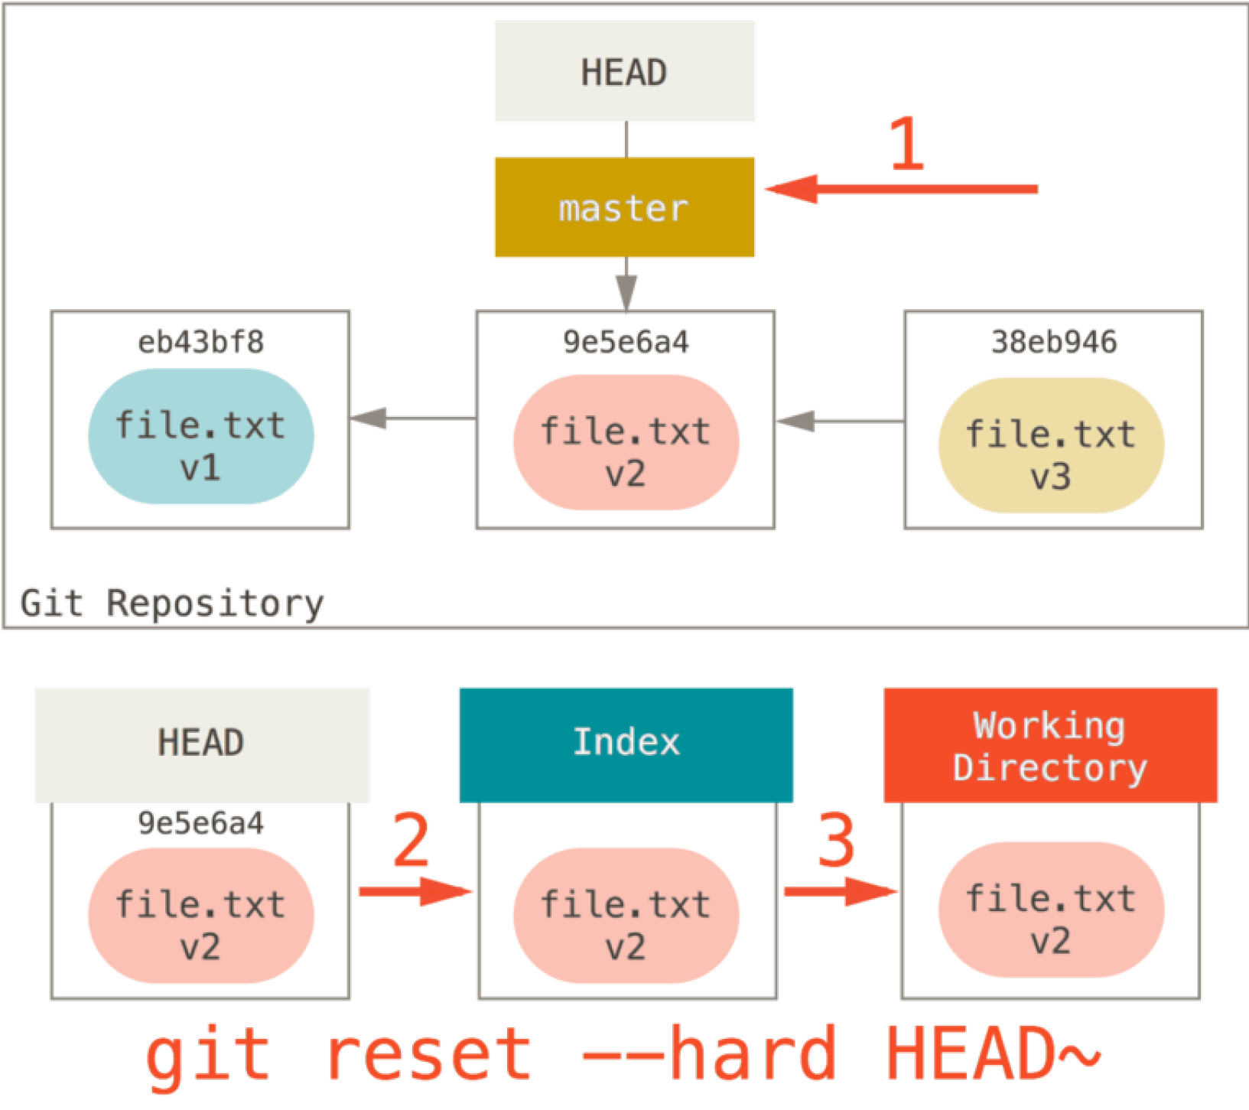
Git Reset
Undo the commit
+
Undo the staging
+
Undo the changes
(Permanently!)

Slide 15
Remote repository
To publish repository to a GitHub (or other place):
Create a repository in GitHub
In your working directory run:
git remote add origin https://github.com/<gitHubID>/<repo>.git
git push -u origin master

Slide 16
Collaboration
Create 2 directories - repo1 and repo2. In the first directory create a repo job_example
mkdir repo1
mkdir repo2
cd repo1
git init job_example
cd job_example

Slide 17
Collaboration
In the first directory (repo1/job_example) add a few file and make a commit. You can copy the file from the examples directory:
cp /project/scv/examples/git/job_example/* .
Make an initial commit:
git add .
git commit -m "Initial commit"

Slide 18
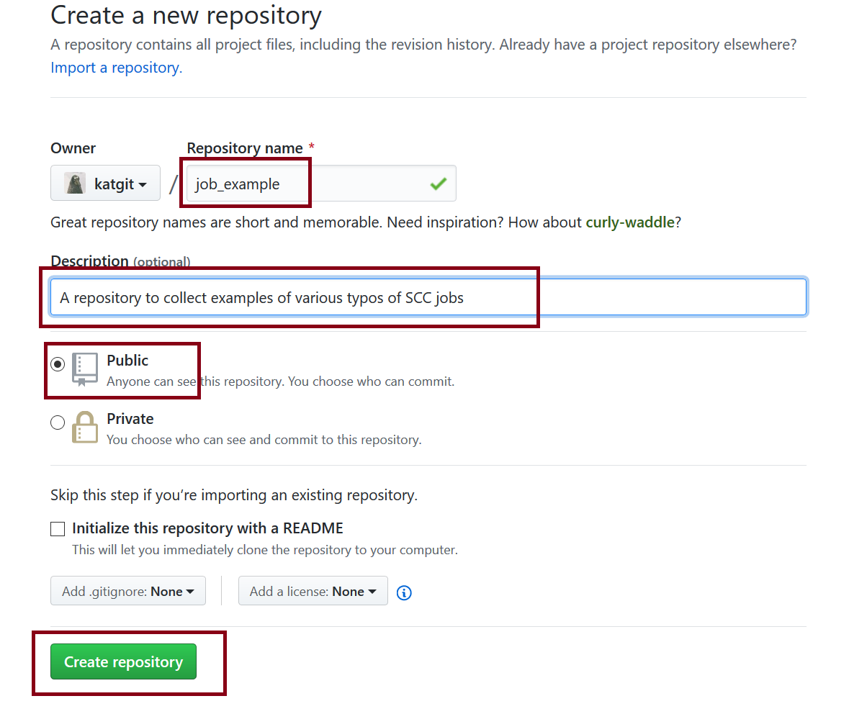
Collaboration
Create a remote repository on GitHub. We will be updating this repository from 2 different directories we created.

Slide 19
Collaboration
# In repo1:
git remote add origin https://github.com/<yourID>/job_example.git
git push -u origin master
# In repo2:
https://github.com/katgit/job_example.git
cd job_example
# To differentiate between 2 repositories, let’s change a local user-name
git config --local user.name "Some Alias"

Slide 20
Collaboration
# In repo2 modify job.qsub
git add job.qsub
git commit –m "modified job.qsub"
# Update Git Hub repository
git push origin master
# In repo1:
git pull origin master

Slide 21
Exercises
https://www.cs.grinnell.edu/~rebelsky/Courses/CSC195/2014S/assignments/git.html

Slide 22
Resolving Conflicts
# In repo1 further modify job.qsub and then commit it
git add job.qsub
git commit –m "added project flag to job.qsub"
# Update Git Hub repository
git push origin master

Slide 23
Resolving Conflicts
# In repo2 modify example.py file and then commit it
git add example.py
git commit –m "added some calculations to example.py"
# Now try to push the changes to the GitHub repo:
git push origin master
! [rejected] master -> master (fetch first)
error: failed to push some refs to 'https://github.com/katgit/job_example.git'
hint: Updates were rejected because the remote contains work that you do
hint: not have locally. This is usually caused by another repository pushing
hint: to the same ref. You may want to first integrate the remote changes
hint: (e.g., 'git pull ...') before pushing again.
hint: See the 'Note about fast-forwards' in 'git push --help' for details.

Slide 24
Resolving Conflicts
# In the repo where you got this errors (repo2) pull the updates from GitHub:
git pull origin master
If 2 different files were modified, git will try to resolve the conflict and will open an editor to record a commit message.
If git is uncertain about which changes to keep, you have to resolve the conflict manually.
# Update Git Hub repository
git push origin master

Slide 25
Branch
Git allows and encourages you to have multiple local branches that can be entirely independent of each other.
g
f
d
e
c
b
dev
a
master

Slide 26
Branch
Create a new branch "dev"
git branch dev
Check existing branches
git branch --list
g
f
d
e
c
b
dev
a
Note: Creating a new branch does not make it current!
master
Notes:
Create branch "dev" and list all the branches

Slide 27
Branch
Use checkout verb to switch between branches, i.e:
git checkout <branch>
Each branch can be modified independently
Eg: Switch to the "dev" branch
git checkout dev
g
f
d
e
c
b
dev
a
master
Notes:
Now, let's create a couple of commits in each branch
git checkout dev
create a new file notes.txt
modify README file to include info about notes.txt file
git checkout master
create a new file hello.py
modify README file to include info about python file

Slide 28
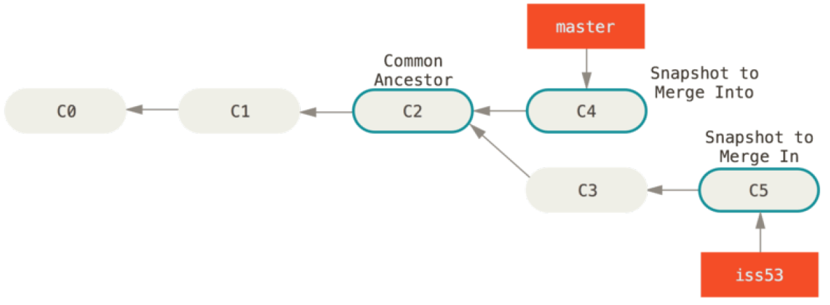
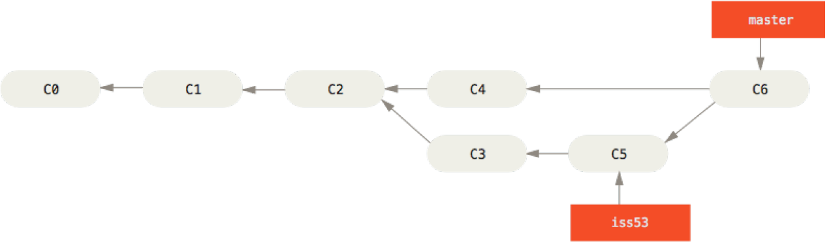
Merging Branches
First checkout to the "receiving" branch:
git checkout master
Perform merge with the other branch
git merge dev
Notes:
git checkout master
git merge dev
A conflict message will be given
Edit README file to resolve conflict
git commit -am "Resolve merge conflict in README file"
git log --graph

Slide 29
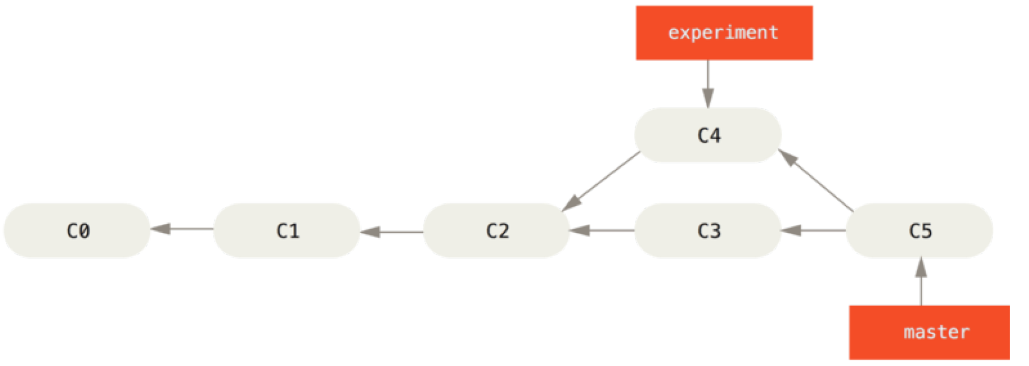
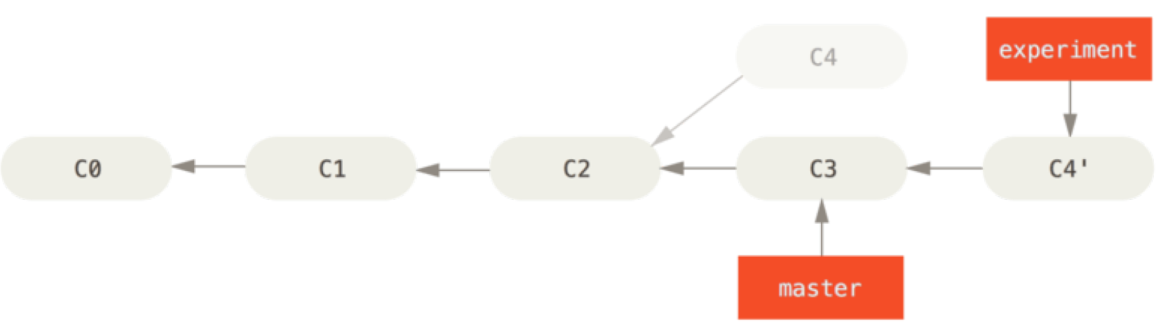
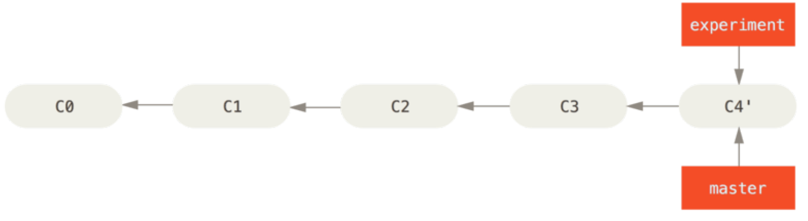
Rebase
First checkout to the “development" branch:
git checkout experiment
Perform rebase
git rebase master
Merging 2 branches
git checkout master
git merge experiment
Notes:
rebase makes your commit history clean

Slide 30
Rebase vs. Merge
Do not rebase commits that exist outside your repository and people may have based work on them!
The way to get the best of both worlds is to rebase local changes you’ve made but haven’t shared yet before you push them in order to clean up your story, but never rebase anything you’ve pushed somewhere.

Slide 31
Pushing Branches to Remote
To push a branch to a remote repository
git push origin dev
List all remote repositories
git branch –l -r
(In repo2 ) Get a particular branch from remote
git fetch origin dev
Get all branches from remote
git fetch origin
git branch –l -r
Notes:
fetch vs pull

Slide 32
Optional Exercises
https://github.com/mariusgrigaitis/git-homework

Slide 33
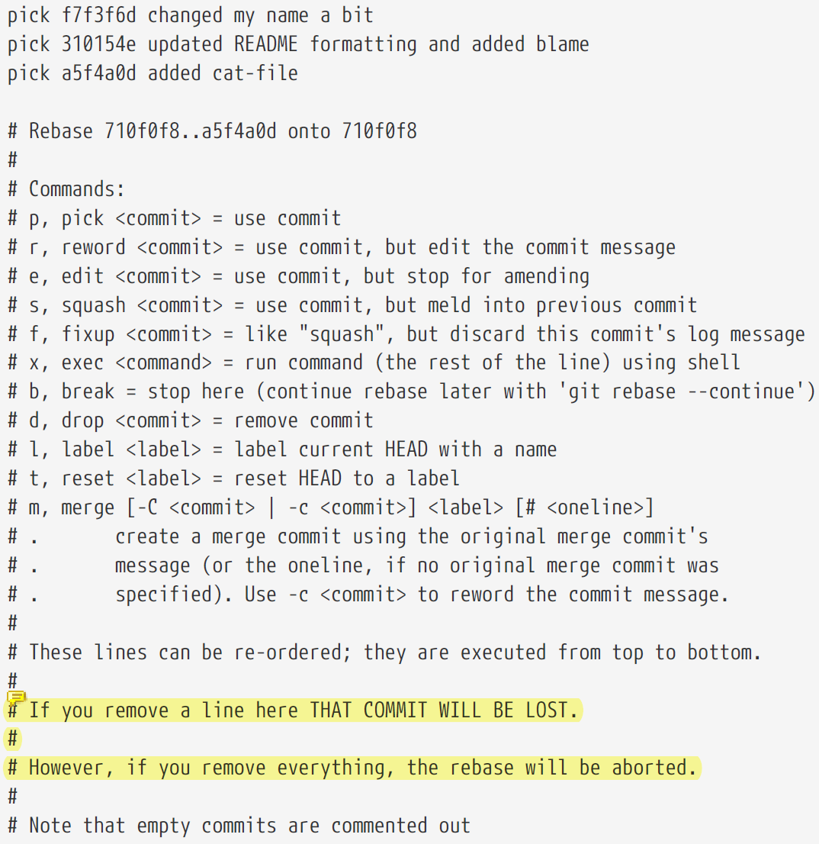
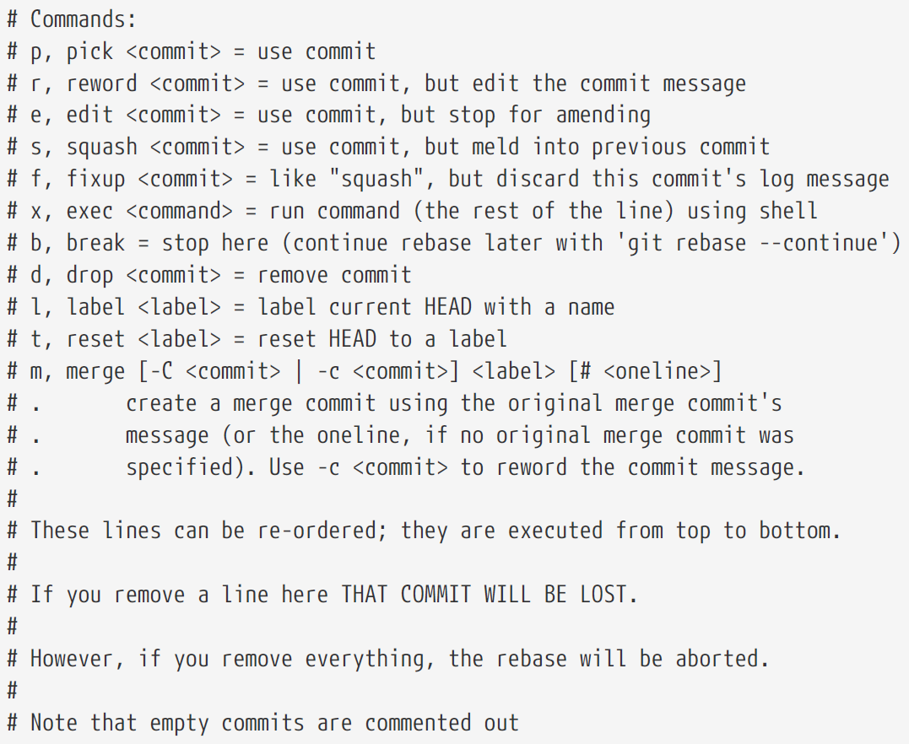
Git tools: Interactive Rebase
Rewriting history
git rebase -i HEAD~3

Slide 34
Git tools: filter-branch
Go nuclear!
git filter-branch --tree-filter 'rm -f passwords.txt' HEAD

Slide 35
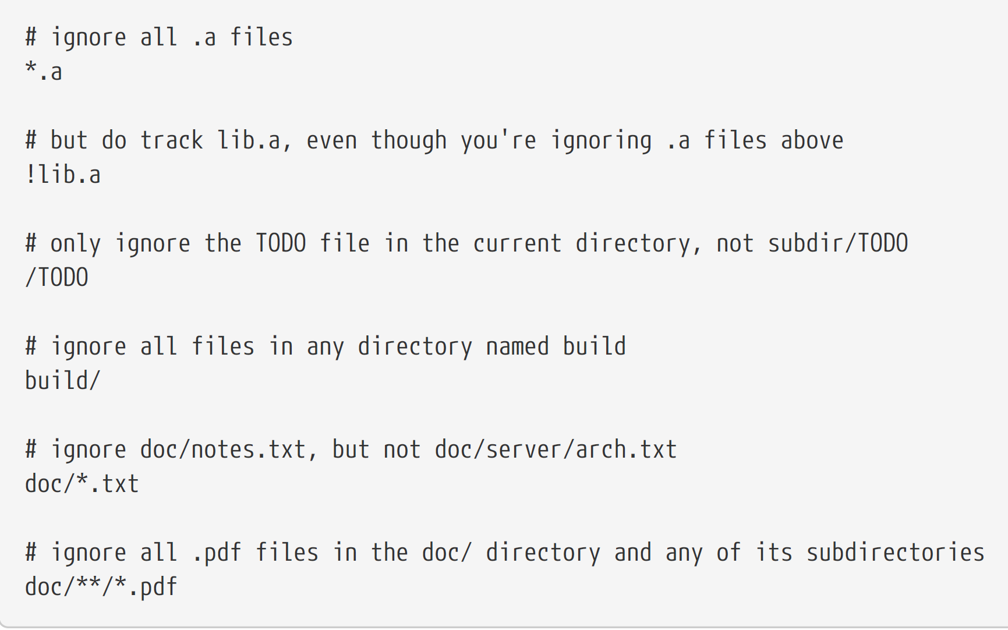
Git tools: Git Ignore
Stop certain files to be version controlled
<- An exemplar .gitignore file
A more realistic example

Slide 36
Git tools: Stashing
Temporarily save your code
When you need to switch between the branches, but are not ready to push the changes you can use stashing area:
# push changes to the stashing area
git stash
# list stashes
git stash list
Now you can switch branches and do other work.
Once you are back to your master branch and are ready to continue your work you can pull stashed files back:
# pull stashed file into your working area
git stash apply
Think careful regarding
[-k|--[no-]keep-index] [-u|--include-untracked]

Slide 37
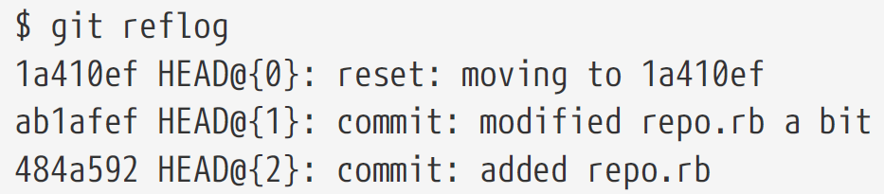
Git tools: RefLog
Revisiting “lost” history

Slide 38
Dangerous Commands
git checkout -- <file>
git reset --hard
git rebase
git stash

Slide 39
Good Practices
Commit Often, Perfect Later, Publish Once
Try to write meaningful & comprehensive commit messages
Do not steal others’ work in PR
PR early then ready
Other Good Practices

Slide 40
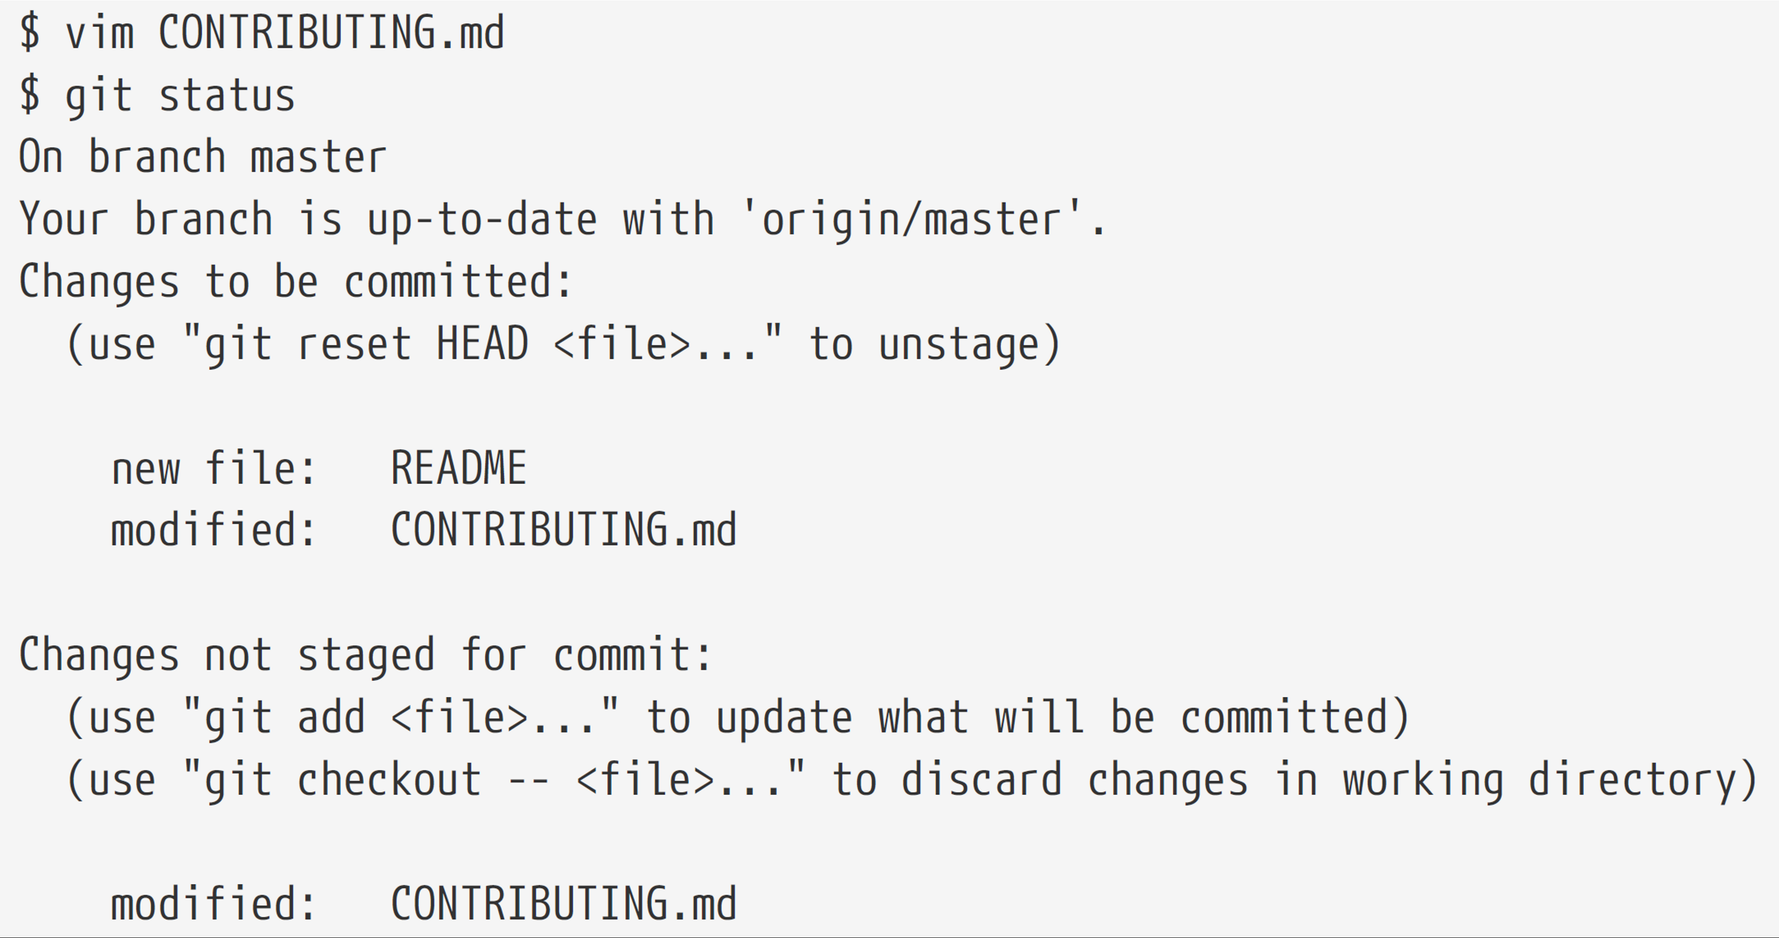
Question

Slide 41
Next Steps
Git Official Website
Hooks
Github
ProGit

Slide 42
Thank You!

